Slide 1
Improving ASR output using a transformer-based Grammatical Error
Correction approach
Rachel Gao, Juliana Gómez-Consuegra, Erica Nakabayashi
DATASCI 266 Natural Language Processing with Deep Learning
rachelgao, julianagc, ericanaka @berkeley.edu
Notes:
Hello everyone
Today we are here with Rachel, Juliana, and me Erica.
To go through our final project.

Slide 2
Motivation, Data and Challenges
ASR Challenges:
Different styles, inflections,
Diverse phonetics,
Words are spelled phonetically without regard to context
Emotion states,
Regional Accents.
High cost associated with the use of common strategies.
Grammatically Annotated Data is scarce, and hard to generate.
Encoder-decoder is computationally expensive, and time consuming.
In this work:
Experimented with Encoder only approach, considering :
Phonetics
Punctuation
NER
Spelling
Casing
hear
here
there
dear
home
…
I/O: I don't know why you're at all.
Datasets:
CoLA
EmoV_DB
Arctic
Notes:
Error correction from Automatic Speech Recognition (ASR) is challenging due to many factors,
Such as
diversity of speaking styles.
Inflections,
Regional Accents,
Emotional states,
Hardware quality, and many other characteristics might interfere on the final transcription.
The usual approach is encoder-decoder based
And it requires costly and hard to generate data,
also being computationally expensive and overall time consuming.
In this work we introduced a transformer-based,
encoder-only
Grammatical Error Correction approach
to improve ASR output.
To achieve so, we used a Grammatical Acceptability Classifier model,
Together with a Grammatical Error Correction model,
which we will discuss further on today.
As for data, we used CoLA set for fine tuning the grammatical acceptability classifier,
and
EmoV DB, and Artic datasets for the Grammar Error Correction.
The last two are commonly used to develop and evaluate text-to-speech systems, and
Share common features as emotional state and gender.

Slide 3
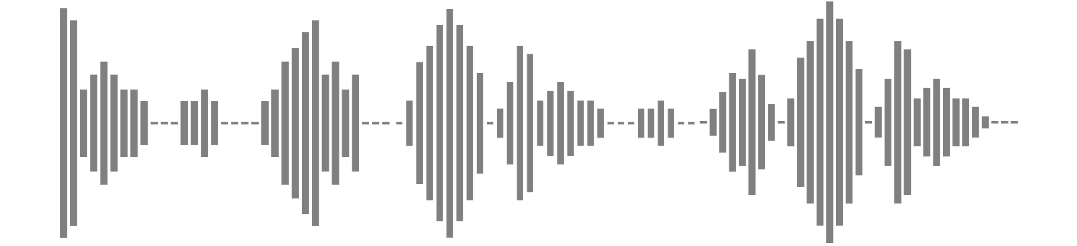
Overall Process
FEATURE
LABEL
FEATURE EXAMPLE
Input
Speech
Text
wav2vec 2.0
ASR Output
Auto Transcription
I DON’T KNOW WHY YOU’RE HEAR AT ALL
Cleaning
Cleaning
I don’t know why you’re hear at all.
GAC (49.58%)
GEC Input
Cleaned Auto Transcription
Cleaned Label
GAC Model
I don’t know why you’re <MASK> at all.
GAC (...)
GEC Process
GEC Model
I don’t know why you’re here at all.
GAC (99.71%) + Evaluation
Evaluation
WER, BLEU, GLEU, BERTScore
Notes:
For our overall process, we start with speech input, which is passed to our ASR system, wav2vec, to produce the auto transcription, it is then cleaned before been passed to the grammatical error correction, or GEC process. The sentences are corrected by using our Pretrained MaskedLM with a MaskedLM approach, where each word in the sentence is masked and predicted. The probability of the predicted sentence is calculated using our FineTuned Grammatical Acceptability Classifier, or GAC, and the original sentence is only replaced if the probability improved by a threshold. We can see the example on the right hand side where the misspelled word ‘hear’ was corrected with the probability increasing from 49 to 99%. The final result is evaluated against the cleaned label using WER, BLEU, and GLEU, metrics commonly used for evaluation of ASR systems, and BERTScore, for evaluation of context and grammar. We experimented with BERT and RoBERTa for finetuning and pretraining our models.

Slide 4
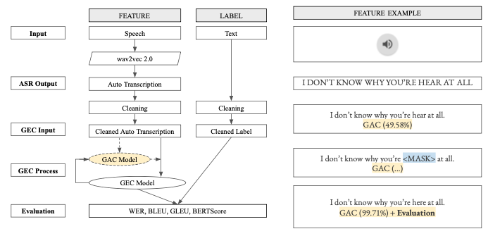
RawGEC - Decision Process
Masked Input
I don’t know why you’re <mask> at all.
MaskedLM
Pretrained MaskedLM
MaskedLM Candidates
['here', 'there', 'crying', 'angry', 'upset', 'worried', 'smiling', …]
Masked Word:
hear
Check Phonetics
Soundex:
['H600', T600', ...]
Metaphone:
['HR', '0R', …]
Soundex:
H600
Metaphone:
HR
Acceptable Candidate(s)
['here']
Candidate Sentence(s)
I don’t know why you’re here at all.
Notes:
For our GEC process, we experimented with different algorithms, and our best performing model is RawGEC. This side shows the decision process. In this example, the misspelled word ‘hear’ was masked, and the pre-trained MaskedLM is used to predict candidates for the masked word, with k-beam = 20. The Soundex and Metaphone phonetics of each candidate is queried and compared against the masked word. Only candidates with phonetics exactly matching the masked word are accepted, then the masked word is replaced with the candidate word to produce the candidate sentence. If there are multiple acceptable candidates, only the candidate sentence with the highest probability is retained.
I will now pass to Juliana to go over the results for each of the GEC algorithms with some examples.

Slide 5
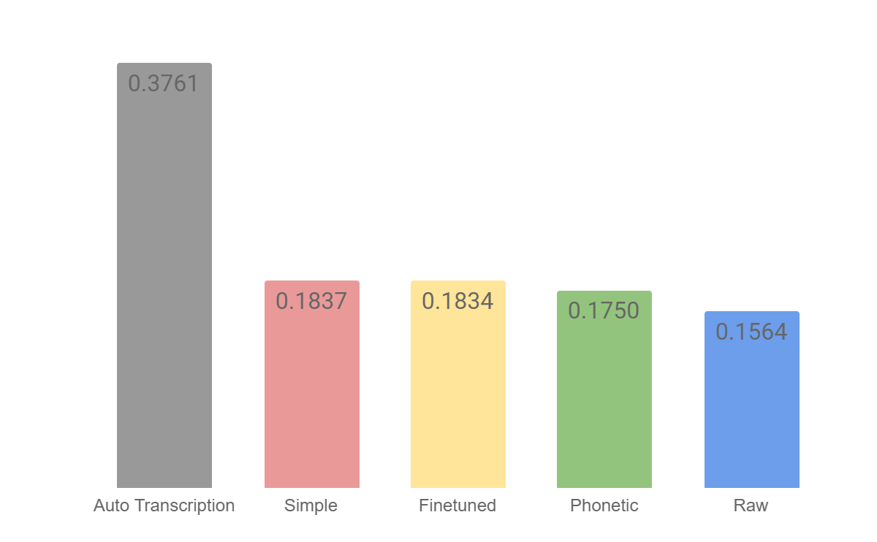
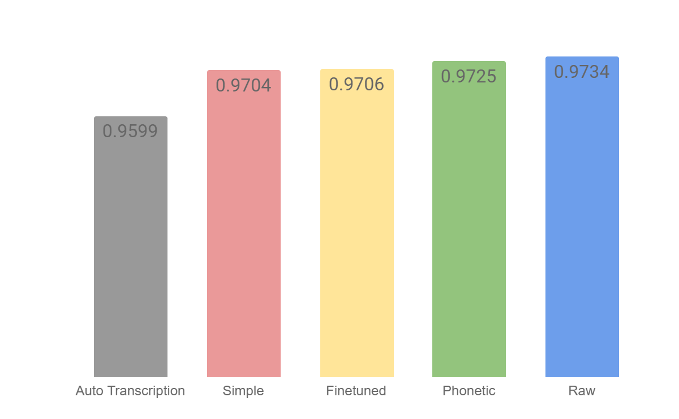
Autotranscription Example
WER
Input:
THE PRESIDENT IS AWAY IN AUSTRALIA ATTENDED A CONFERENCE<>
(GAC~ 0.3790)
Label:
The President is away in Australia attending a conference.
(GAC~ 0.9996)
BERTScore F1
Notes:
Thank you, Rachel.
Rachel mentioned multiple evaluation metrics. Throughout the rest of this presentation, however, we will focus on two of those: WER and BERTScore F1, since they evaluate different aspects of ASR error correction. WER considers substitutions, among others, while BERTScore F1 uses BERT embeddings to evaluate the F1 score.
In this example, we see that the input sentence, coming from our GAC model with a low grammatical acceptability score, obtained a WER of around 0.37 and a F1 score of 0.95. The differences being attributable to Named Entity Recognition (Australia in all caps), and verb tenses (attending vs. attended).
37 seconds

Slide 6


SimpleGEC and PretrainedGEC
WER
PretrainedGEC:
The president is away in australia RAL a conference<>
(GAC~ 0.7280)
Label:
The President is away in Australia attending a conference.
(GAC~ 0.9996)
BERTScore F1
Notes:
SimpleGEC and PretrainedGEC did not show many differences in performance between them, but they did show an improvement in both metrics, compared to the autotranscription.
Though PretrainedGEC still struggled with punctuation and capitalization, we can see that the output shown here is more grammatically acceptable than the original input, but it includes a nonsense word and is missing punctuation.
19 seconds

Slide 7
PhoneticGEC
WER
PhoneticGEC:
The president is away in australia attended a conference<>
(GAC~ 0.3790)
Label:
The President is away in Australia attending a conference.
(GAC~ 0.9996)
BERTScore F1
Notes:
PhoneticGEC shows an improvement in WER and F1 over the previous models, but we see that the candidate sentence is faithful to the input, and not the label, since the GAC score is identical to that of the input.
11 seconds

Slide 8
RawGEC
WER
RawGEC:
The president is away in Australia attending a conference.
(GAC~ 0.9944)
Label:
The President is away in Australia attending a conference.
(GAC~ 0.9996)
BERTScore F1
Notes:
Finally, RawGEC solved most of the problems we noticed in the other models.
This improvement is reflected in all metrics: WER, F1, and GAC score.
12 seconds

Slide 9
Overall
WER
Best Performing GEC:
The president is away in Australia attending a conference.
(GAC~ 0.9944)
Label:
The President is away in Australia attending a conference.
(GAC~ 0.9996)
BERTScore F1
Notes:
As you can see, our RawGEC outperformed all other models in terms of WER, and marginally outperformed them in terms of BERTScore, so we can conclude that it is better at correcting for substitutions, but only marginally better at correcting grammatical errors.
32 seconds

Slide 10
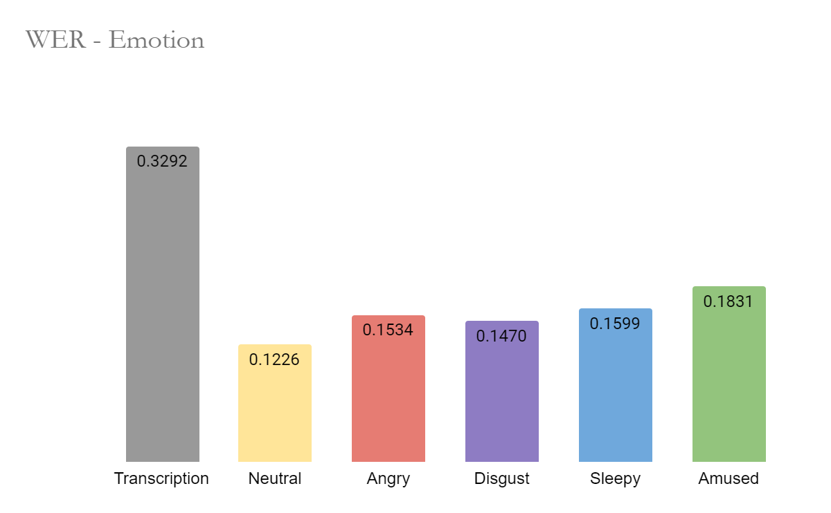
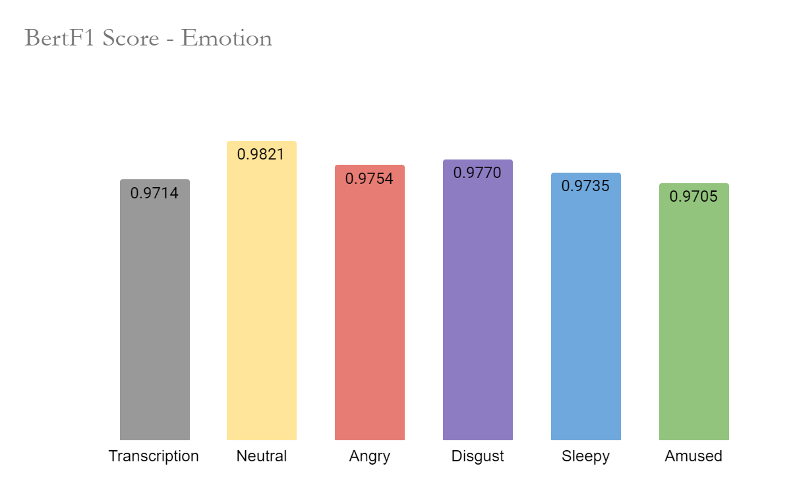
Inspiration for Future Research
Notes:
We also wanted to see whether emotions and gender played a part in how well the model performed, so using a data subset, we evaluated performance, and
Found that neutral emotions were the easiest to correct, while sleepy and amused were the hardest to correct.

Slide 11
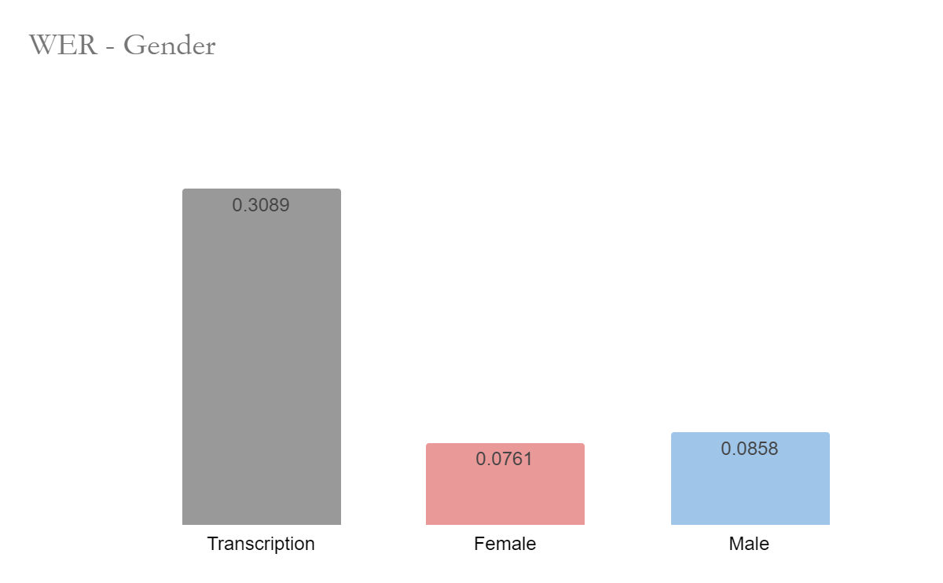
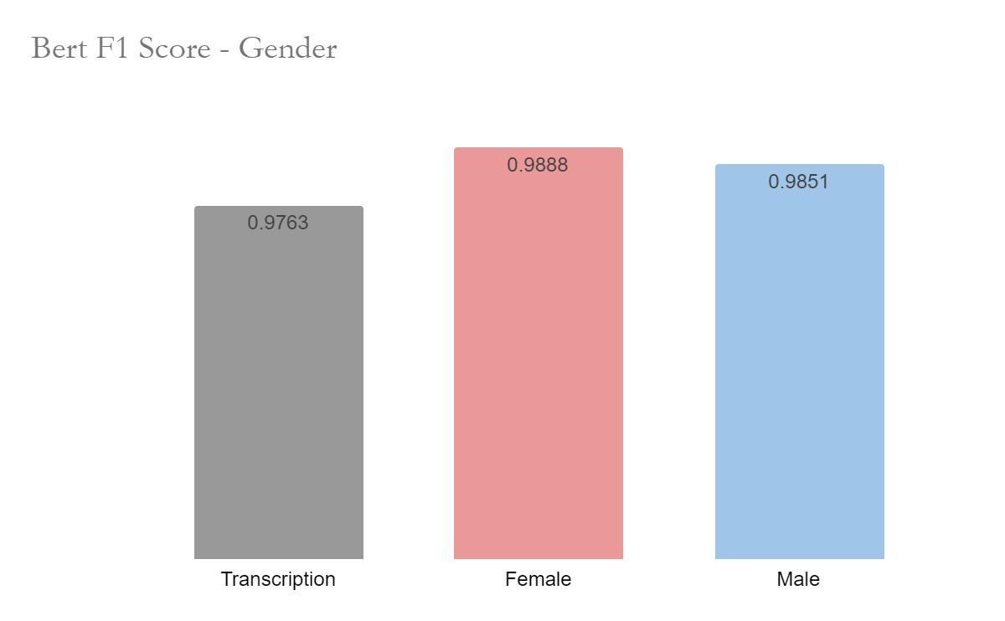
Inspiration for Future Research
Notes:
We also found that sentences spoken by female actors were easier to correct, perhaps because of the higher voice pitch, but we would need future research to confirm this.
For future research, we would like to perform adversarial training, using a dataset that includes different accents, given that our dataset only included native speakers, and our task becomes even more difficult with non-native speakers, so we would like to improve bias and fairness in our model.
Since we’re close to our 5 minute mark, I will end here, and open the room up for questions. Thank you!

Slide 12

Thank you! Questions?
Rachel Gao, Juliana Gómez-Consuegra, Erica Nakabayashi
DATASCI 266 Natural Language Processing with Deep Learning
rachelgao, julianagc, ericanaka @berkeley.edu

Slide 13
Sentence Examples
AutoTranscription | THE RESIDENT COMMISSIONERS AWAY IN AUSTRALIA | PHILIP STOOD UNDECIDED HIS EARS STRAINED TO CATCH THE SLATEST SOUND
Label | The Resident Commissioner is away in Australia. | Philip stood undecided, his ears strained to catch the slightest sound.
Best Model | RawGEC 0.25 | RawGEC 0.25
BM Prediction | The resident commissioners away in Australia. | Philip stood undecided his ears strained to catch the slightest sound.
Alternative Model | SimpleGEC / FinetunedGEC | SimpleGEC
Other Prediction | The resident is away in australia. / The resident commissioners are in australia. | Philip stood, undecided. His ears strained to catch the slatest sound.
Obs | None recognized Resident Comissioner as an Named Entity, misaligned : needed one token position added for full correction, BM recognized and capitalized Australia. | Noise introduced from “cleaning model”, wrong punctuation. Phonetic approach working with slightest vs. SLATEST.
Notes:
As for GEC models:
We experimented with a few different set ups. Worth noting are Simple, FineTuned, Phonetic, Raw.
Simple is consists of the previous algorithm using TFRoBERTaforMaskedLM to predict the masked word with k-beam = 3
FineTuned is similar to Simple, but Finetuned with our dataset.
Phonetic is the previous, with a larger k - beam, and adding phonetic rules, using metaphone and soundex.
RawGEC is the final version of our algorithm, using all previous steps but with a different logic.
Here we will present a few output examples, and some differences in between the suggestions.
The difference in between them are:
…..
As you can observe on the table:
….
Use cleaning noise to hook up rawgec explanation…

